Slide 1
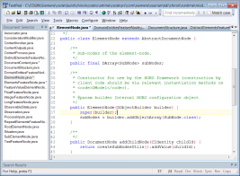
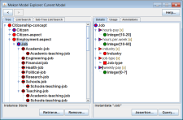
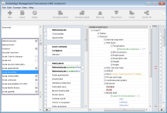
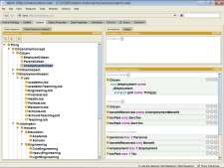
MEKON & HOBO
Java frameworks for building
ontology-driven applications
HOBO
Mixed-Access Applications
Generic-Access Applications
Domain-Specific API
Object Model
API access
Clinical Doc. Sys.
Standard IDE
Recruitment App.
model flow
Model Explorer
API access
API access
MEKON
Domain-Neutral API
Frames Model
Instantiations
OR
model flow
Assertion
Query
Modelling Format X
Plug-ins
model flow
driven-by
stored-in /
executed-over
Reasoner
Current Options…
same-as
OWL + DL
BaseX (XML DB)
RDF + SPARQL
X Editor
Protege
OWL + DL
Instance Storage
Colin Puleston, University of Manchester (puleston@manchester.ac.uk)

